Slide 1

CSE 412: Artificial Intelligence
Lecture 1: Introduction
Department of CSE
Daffodil International University
<number> of 29

Slide 2
Topic Contents
  What Is AI?
  The Foundations of Artificial Intelligence
  The History of Artificial Intelligence
  The State of the Art
  Philosophical Foundations
  Logic Programming Language
<number> of 29

Slide 3
What Is AI?
AI (Artificial Intelligence) is a branch of computer science concerned with the study and creation of computer systems that exhibit some form of intelligence:
  systems that learn new concepts and tasks,
  systems that can reason and draw useful conclusions about the world around us,
  systems that can understand a natural language or perceive and comprehend a visual scene, and
  systems that perform other types of feats that require human types of intelligence.
<number> of 29

Slide 4
What Is AI?...
Systems that think like humans | Systems that think rationally
Systems that act like humans | Systems that act rationally
<number> of 29

Slide 5
Major Branches of AI
Artificial Neural Networks
Computer Vision
Expert Systems
Fuzzy Systems
Game Artificial Intelligence
Heuristic Search
Knowledge Management
Machine Learning
Metaheuristic and swarm intelligence
Natural Language Processing
Pattern Recognition
Robotics
Virtual Intelligence
<number> of 29

Slide 6
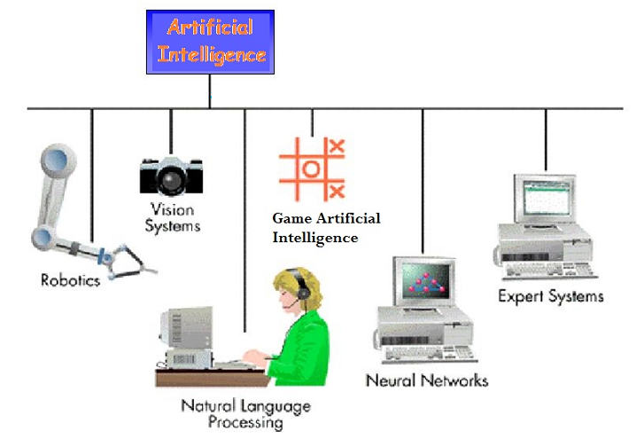
Major Branches of AI…
<number> of 29

Slide 7
The Foundations of AI
A brief history of the disciplines that contributed ideas, viewpoints, and techniques to AI is provided here.
The history is organized around a series of questions.
It is not wished to give the impression that these questions are the only ones the disciplines address or that the disciplines have all been working toward AI as their ultimate fruition.
<number> of 29

Slide 8
The Foundations of AI…
Philosophy (428 B.C. – present)
  Can formal rules be used to draw valid conclusions?
  How does mental mind arise from a physical brain?
  Where does knowledge come from?
  How does knowledge lead to action?
Mathematics (800 B.C. – present)
  How are the formal rules to draw valid conclusions?
  What can be computed?
  How do we reason with uncertain information?
    Algorithms
    Intractability
    NP-completeness
    probability
<number> of 29

Slide 9
The Foundations of AI…
Neuroscience (1861 – present)
  How do brain process information?
    Neurons
Economics (1776 – present)
  How do we make decisions so as to maximize payoff?
  How should we do this when others may not go along?
  How should we do this when the payoff may be far in the future?
    Decision theory ( probability theory + utility theory)
<number> of 29

Slide 10
The Foundations of AI…
Computer Engineering (1940 – present)
  How can we build an efficient computer?
Cybernetics (1948 – present)
  How can artifacts operate under their own control?
Psychology (1879 – present)
  How do human and animals think and act?
Linguistics (1957 – present)
  How do languages relate to thought?
<number> of 29

Slide 11
The Foundations of AI…
What is Cybernetics?
  The term cybernetics was coined by Norbert Wiener,
  an American mathematician of the twentieth century.
  The scientific study of communication and control processes in biological, mechanical, and electronic systems.
  The study of human control functions and of mechanical
  and electronic systems designed to replace them, involving
  the application of statistical mechanics to communication
  engineering.
<number> of 29

Slide 12
The Foundations of AI…
Are AI and Cybernetics the same subject?
No.
AI and Cybernetics are widely misunderstood to be the same subject.
However, they differ in many dimensions.
<number> of 29

Slide 13
The History of AI
The gestation of AI (1943 – 1955)
The birth of AI (1956)
Early enthusiasm, great expectations (1952 – 1969)
A dose of reality (1966 – 1973)
  Genetic algorithm
Knowledge base systems (1969 – 1979)
AI becomes an industry (1980 – present)
The return of neural network (1986 – present)
AI becomes a science (1987 – present)
<number> of 29

Slide 14
The State of the Art
Autonomous planning and scheduling
Game playing
Autonomous control
Medical diagnosis
Logistic planning
Robotics
Language understanding and problem solving
etc.
<number> of 29

Slide 15
Philosophical Foundations
Philosophers have been around far longer than computers and have been trying to resolve some questions that relate to AI:
  How do minds work?
  Is it possible for machines to act intelligently in the way that people do, and if they did, would they have real, conscious minds?
  What are the ethical implications of intelligent machines?
<number> of 29

Slide 16
Philosophical Foundations…
The assertion that machines could act as if they were intelligent is called the weak AI hypothesis by philosophers.
The assertion that machines that do so are actually thinking (not just simulating thinking) is called the strong AI hypothesis.
<number> of 29

Slide 17
Philosophical Foundations…
Philosophers are interested in the problem of comparing two architectures—human and machine.
Furthermore, they have traditionally posed the question not in terms of maximizing expected utility but rather as, "Can machines think?”
<number> of 29

Slide 18
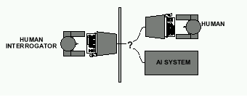
Philosophical Foundations…
Alan Turing suggested that instead of asking whether machines can think, we should ask whether machines can pass a behavioral intelligence test, which has come to be called the Turing Test.
  The test is for a program to have a conversation (via online typed messages) with an interrogator for five minutes. The interrogator then has to guess if the conversation is with a program or a person; the program passes the test if it fools the interrogator 30% of the time.
<number> of 29

Slide 19
Philosophical Foundations…
Turing conjectured that, by the year 2000, a computer with a storage of 10⁹ units could be programmed well enough to pass the test.
He was wrong — programs have yet to fool a sophisticated judge.
On the other hand, many people have been fooled when they didn't know they might be chatting with a computer.
    The ELIZA program
    The Internet chatbots such as MGONZ and NATACHATA
    The chatbot CYBERLOVER
<number> of 29

Slide 20
Philosophical Foundations: A Big Controversy
Eugene Goostman is a chatterbot developed in Saint Petersburg in 2001 by a group of three programmers; the Russian-born Vladimir Veselov, Ukrainian-born Eugene Demchenko, and Russian-born Sergey Ulasen.
The Goostman bot has competed in a number of Turing test contests since its creation, and finished second in the 2005 and 2008 Loebner Prize contest.
<number> of 29

Slide 21
Philosophical Foundations: A Big Controversy
In June 2012, at an event marking what would have been the 100th birthday of the test's namesake, Alan Turing, Goostman won a competition promoted as the largest-ever Turing test contest, in which it successfully convinced 29% of its judges that it was human.
On 7 June 2014, at a contest marking the 60th anniversary of Turing's death, 33% of the event's judges thought that Goostman was human; the event's organiser Kevin Warwick considered it to have passed Turing's test.
<number> of 29

Slide 22
Philosophical Foundations: A Big Controversy
The validity and relevance of the announcement of Goostman's pass was questioned by critics.
Altough there had been several claims that the Turing test is not the best way to test a computer's intelligence, Turing test remains the most popular one.
<number> of 29

Slide 23
Philosophical Foundations: Some Facts about Turing Test
The field of AI as a whole has paid little attention to Turing test.
Few AI researchers pay attention to the Turing test, preferring to concentrate on their systems' performance on practical tasks, rather than the ability to imitate humans.
Arguments for and against strong AI are inconclusive.
Few mainstream A1 researchers believe that anything significant hinges on the outcome of the debate.
<number> of 29

Slide 24
Logic Programming Language
Logic programming is a type of programming languages, in which a program is written as a set of sentences in logical form, expressing facts and rules about some problem domain.
A program is executed by an inference engine that answers a query by searching these sentences systematically to make inferences that will answer a query.
Major logic programming language families include Prolog, Answer set programming (ASP) and Datalog.
<number> of 29

Slide 25
Introduction to Prolog
Prolog: Programming in Logic
Prolog is a logic programming language.
Programming in Prolog is accomplished by creating a data base of facts and rules about objects, their properties, and their relationships to other objects.
Queries can be posed about the objects and valid conclusions will be determined through a form of inferencing control known as resolution.
Facts: sister(sarah, bill).
parent(ann, sam).
parent(joe, ann).
male(joe).
female(ann).
<number> of 29

Slide 26
Introduction to Prolog…
Rules:
  grandfather(X, Z) :- parent(X,Y), parent(Y,Z), male(X).
  For all X, Y, and Z:
  X is the grandfather of Z
  If X is the parent of Y, and Y is the parent of Z and X is a male.
<number> of 29

Slide 27

Thank you

